Slide 1
Presentation Groups
GROUP 3 – Non-vocal Social Communication
Barahona kathypaz
Chen yongting
Vargas vargasj
GROUP 4 – Navigational Senses
Feng fengm
Rakoczy mayarak
Ussui Anzai juaya
GROUP 5 – Vocal Communication
Broitman sharar
Aguilar anisah
Svagdis esvagdis
GROUP 1 – Time Perception
Joncas ejoncas
Wang songyw
Sena ksena
GROUP 2 – Pain Perception
Chan achan22
Liberti libertig
Zea mzea
Mody pnmody

Slide 2
ADULT PLASTICITY

Slide 3
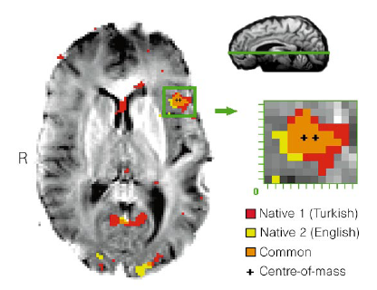
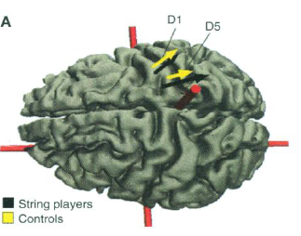
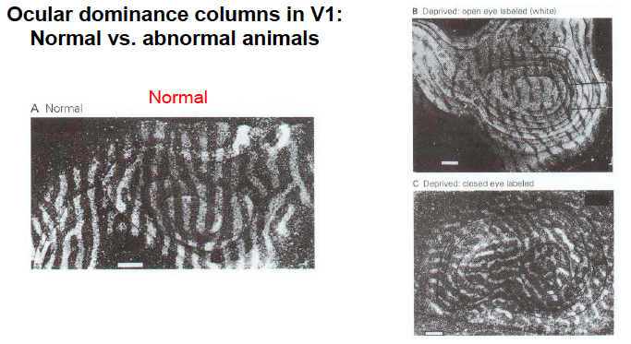
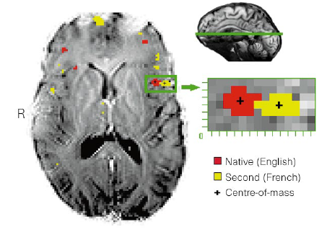
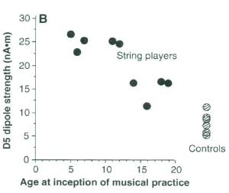
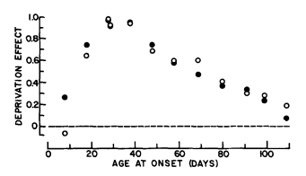
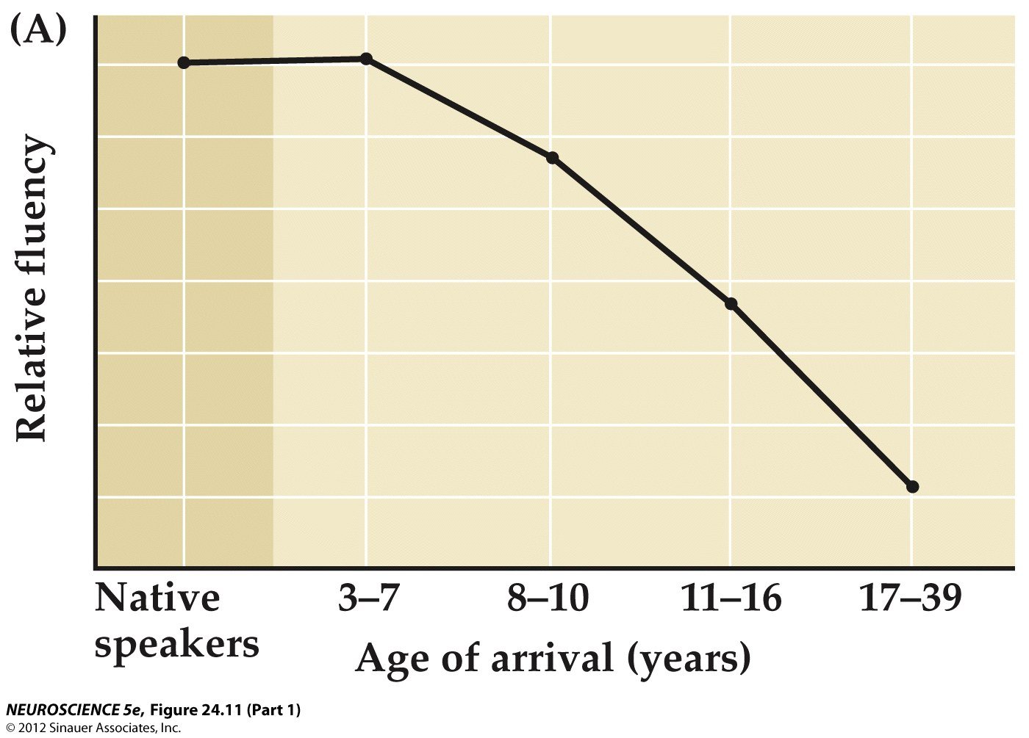
Critical periods - reminder
Cat visual cortex
Human language
Musical ‘ability’
normal
monocular deprivation

Slide 4
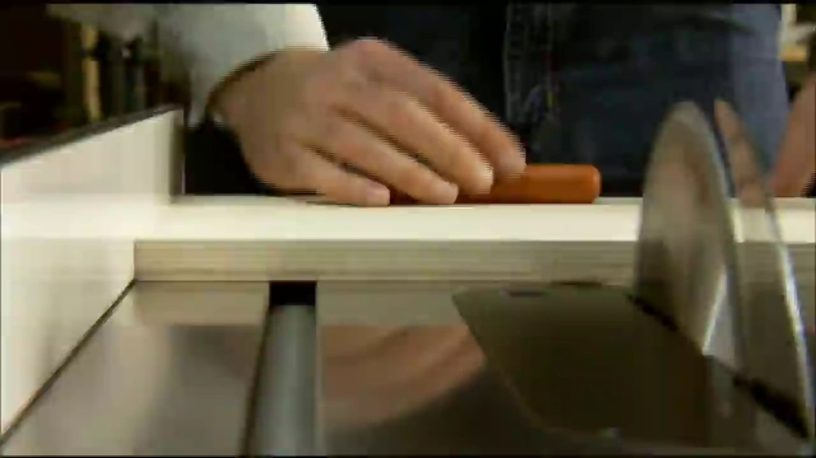
Cortical remapping in adulthood
Woodworking safety: meet the SawStop

Slide 5
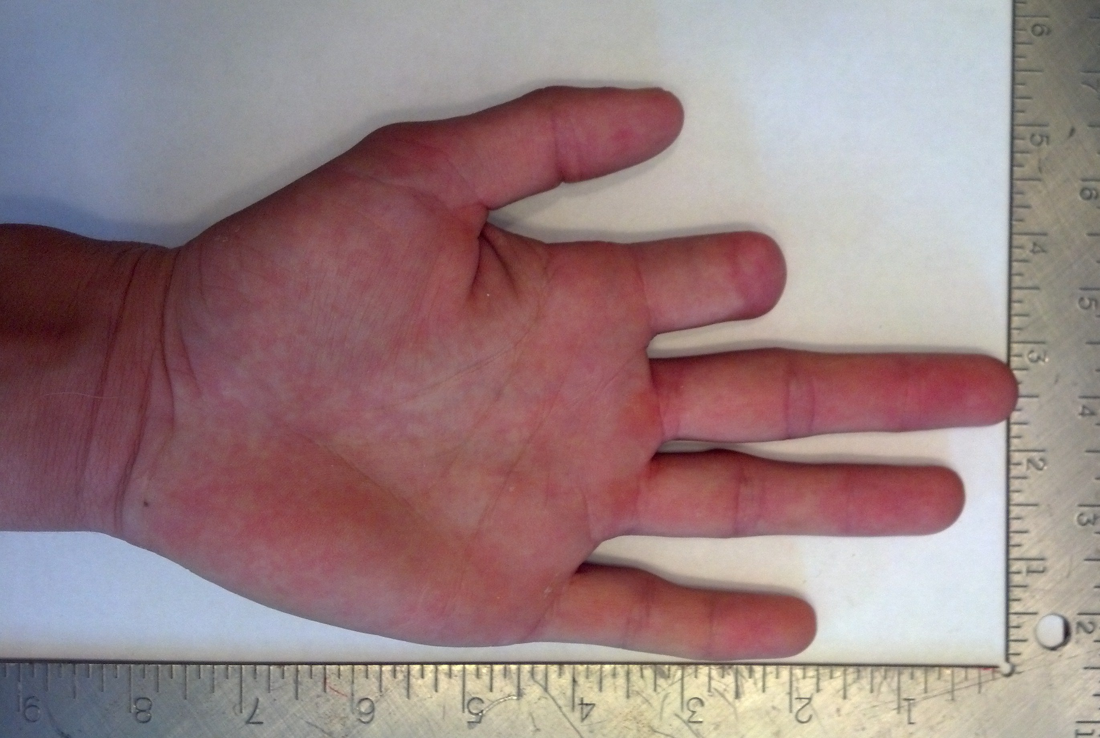
Cortical remapping in adulthood
Woodworking safety: meet the SawStop
Why? ~4000 people cut off their finger with a table saw every year...

Slide 6
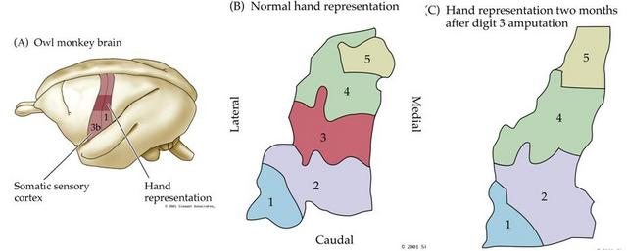
Cortical remapping in adulthood
- while the capacity for plasticity is greatly decreased after the end of critical periods, it can still occur (albeit with a slower time course)
- example: after LOSS of a sensory input (here from a digit on the hand), the cortical area receiving this input is taken over by sensory inputs from adjacent regions

Slide 7
Cortical remapping in adulthood
- while the capacity for plasticity is greatly decreased after the end of critical periods, it can still occur (albeit with a slower time course)
- example: after LOSS of a sensory input (here from a digit on the hand), the cortical area receiving this input is taken over by sensory inputs from adjacent regions

Slide 8

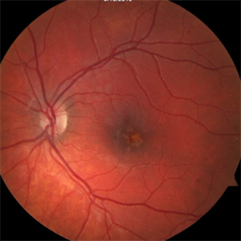
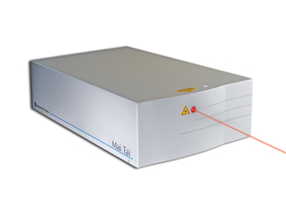
Mechanisms for plasticity – intracortical rewiring
Outdoorstactical.com: ‘Have you ever wanted your very own lightsaber? ’
Spectra Physics Mai Tai: two-photon imaging

Slide 9
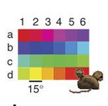
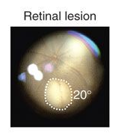
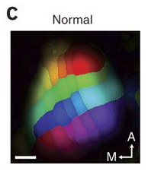
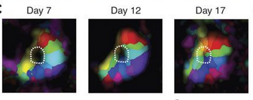
Mechanisms for plasticity – intracortical rewiring
Visual field
Cortical sensory map
After injury, adjacent regions of the visual field gradually take over the cortical territory previously occupied by the lesioned retinal input
Normal map of visual space in mouse V1

Slide 10
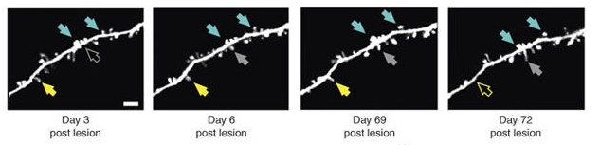
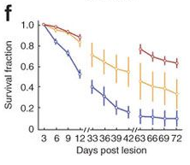
Mechanisms for plasticity – intracortical rewiring
What’s happening in the brain? Use imaging to track changes in synaptic connections in individual cortical neurons by visualizing dendritic spines.
control
Normally, the majority of cortical synapses remain stable over long time periods. Following retinal lesions, there is a near-complete replacement of ~90% of synapses onto neurons in the area corresponding to the lesion.
lesion

Slide 11
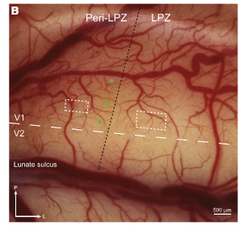
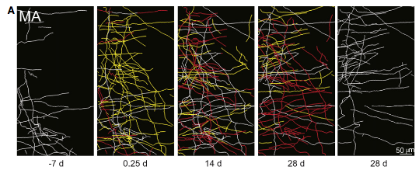
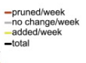
Mechanisms for plasticity – intracortical rewiring
- similarly, the structure of axonal connections in cortex is highly stable, but retinal lesions lead to a dramatic increase in new sprouting followed by pruning.
- e.g. after loss of sensory input, corresponding cortical regions undergo a period of growth followed by selective stabilization and loss that recapitulates development.

Slide 12
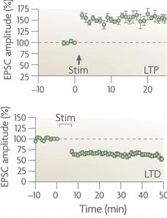
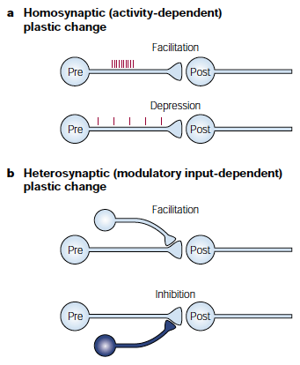
Facilitating plasticity: METAplasticity
- long-standing finding in synaptic transmission: connection strength depends on past activity activity at a synapse; strength can either increase (brief, intense bursts) or decrease (prolonged low-frequency inputs)

Slide 13
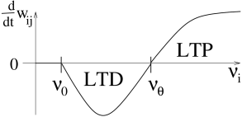
Facilitating plasticity: thresholds for change
change in synaptic strength
the ‘BCM’ learning rule: synaptic strength either increases or decreases depending on the intensity of activity:
low (uncorrelated) activity → depression;
higher levels of activity → potentiation

Slide 14
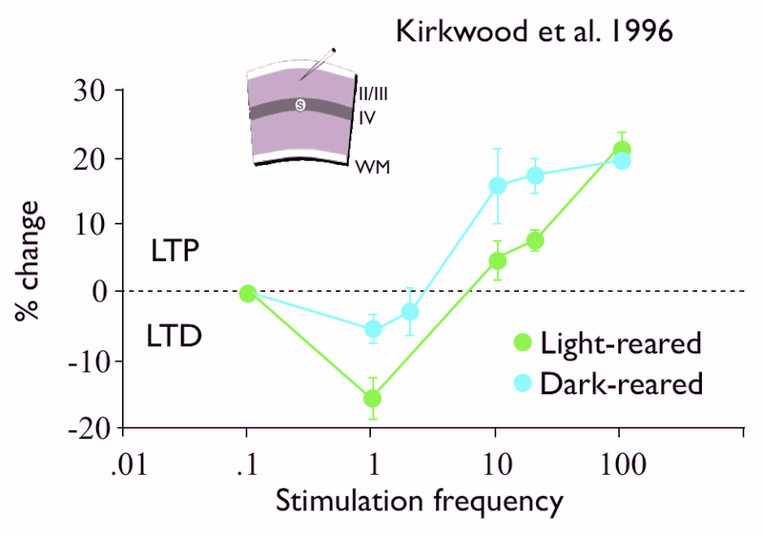
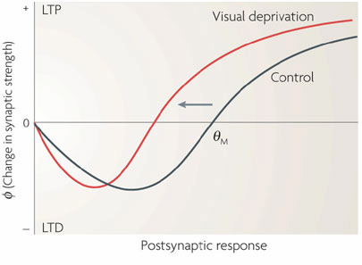
Facilitating plasticity: METAplasticity
- on long timescales, changes in ongoing activity levels lead to ‘metaplasticity’ – plasticity of plasticity – that shifts the threshold for changes in synaptic strength.
- Prolonged periods of lower activity (e.g. dark-rearing) → lowers threshold for increasing synaptic strength.

Slide 15
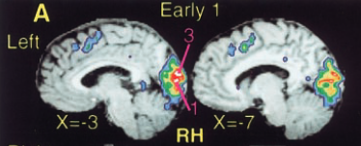
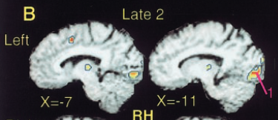
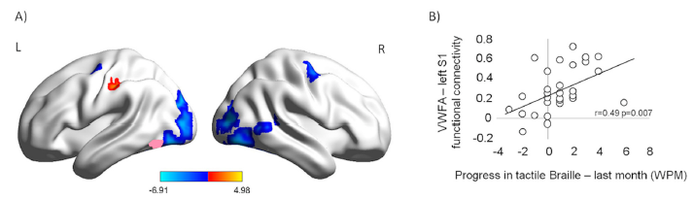
Cortical remapping in adulthood
- dramatic plasticity an also occur across sensory systems – as in Braille readers
- plasticity is much more pronounced for early vs. late onset of blindness
- and increases the functional coupling between visual cortex and visual word form areas (in sighted readers)

Slide 16
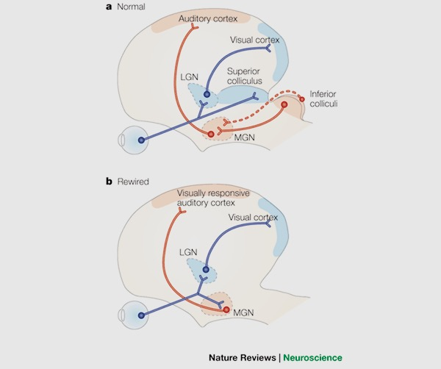
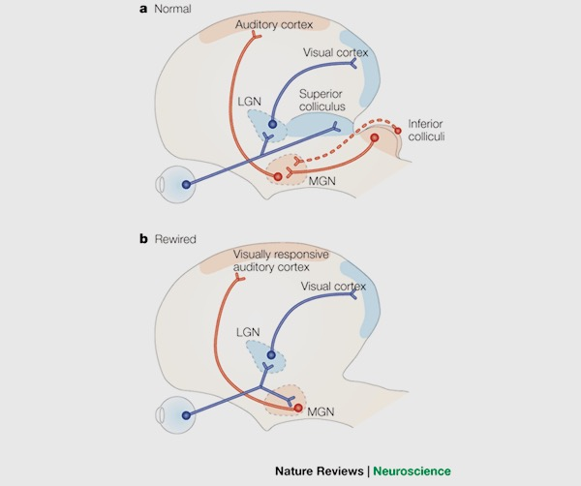
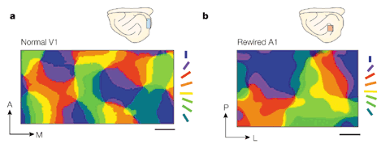
Just how plastic is cortex anyhow??
- Experiment: early in development, redirect connections from retina to auditory thalamus
- results in the formation of apparently normal maps and sensory responses in AUDITORY cortex, as well as reasonable sensory acuity

Slide 17
Perceptual learning

Slide 18
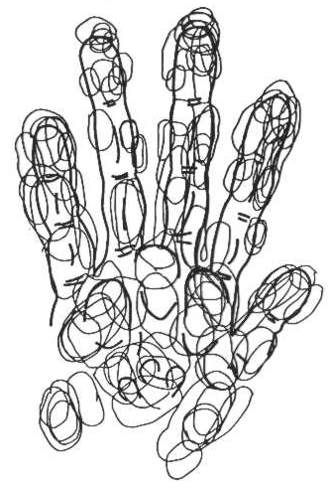
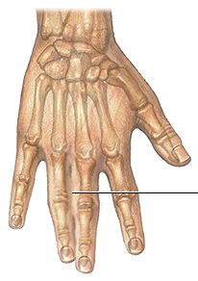
Cortical remapping in adulthood
- normally, receptive fields of cortical neurons respond to areas on separate digits

Slide 19
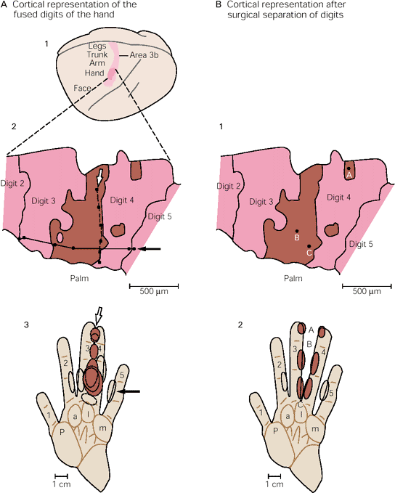
Cortical remapping in adulthood
- normally, receptive fields of cortical neurons respond to areas on separate digits
- but, if digits are fused, receptive fields begin to bridge both fingers
fingers fused
fingers separated
- In other words – cortical maps don’t just fill in for missing inputs, but adapt to reflect the structure of incoming sensory input

Slide 20
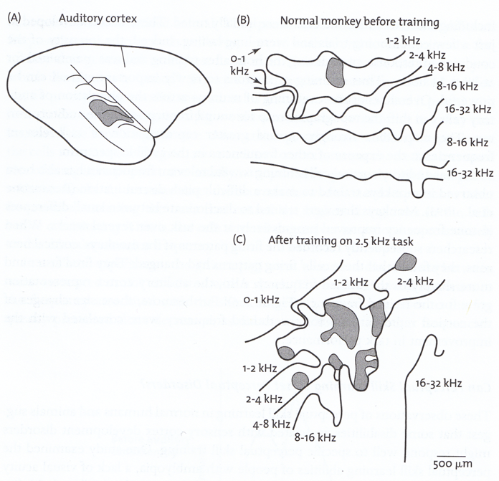
Facilitating plasticity – auditory training
- remapping occurs not only after injury or loss of function, but also with changes in sensory experience
- training on an auditory discrimination task increases the cortical representation of the trained/rewarded cue in monkey experiments

Slide 21

Facilitating plasticity – visual training

Slide 22

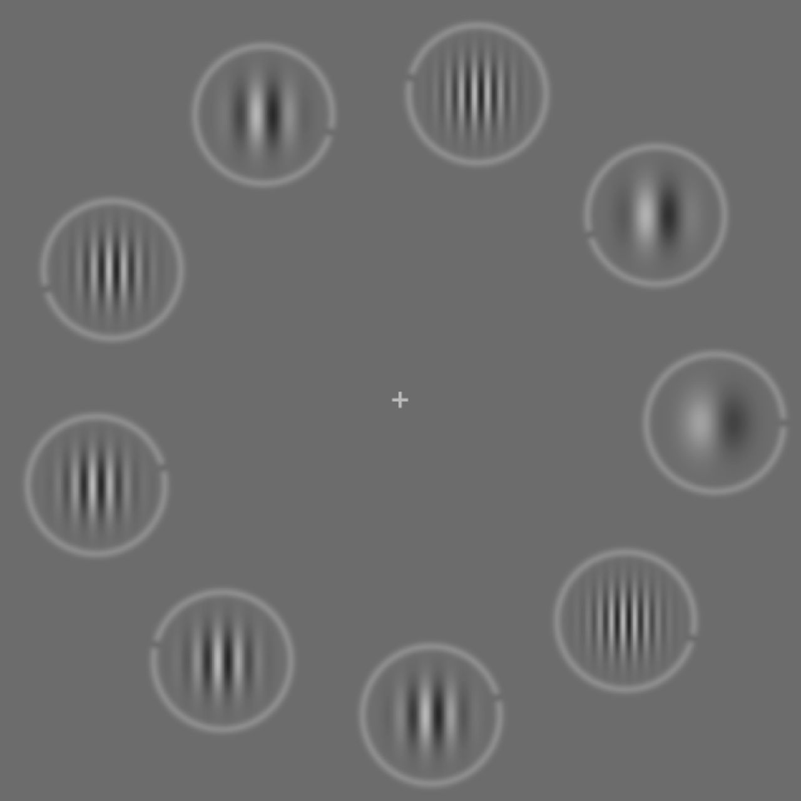
Facilitating plasticity – visual training
- the VizionEdge system: extensive training on Gabor patches: emphasis on (1) detecting faint, low-contrast signals – improve sensitivity; (2) detecting high-spatial frequency signals – improve acuity; and (3) making judgments based on rapid visual presentations – improve speed of processing.

Slide 23
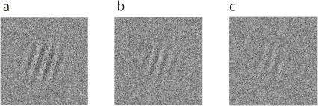
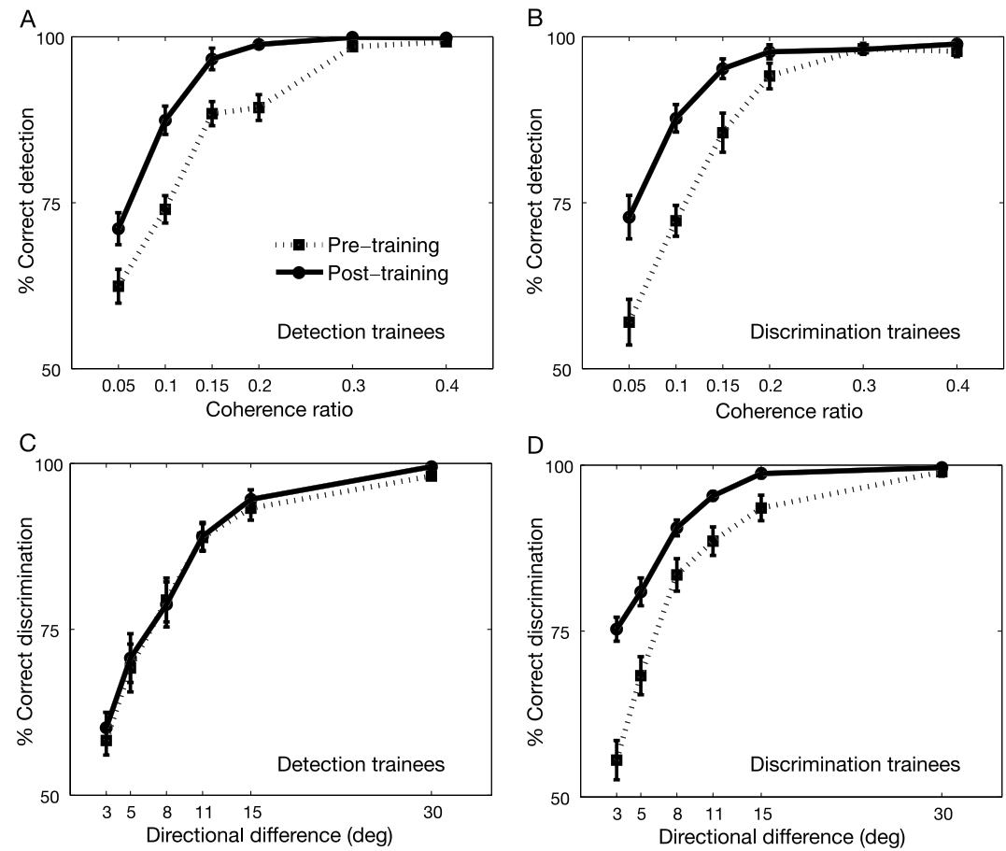
Facilitating plasticity – visual training
- task: detect oriented visual gratings; (1) present? (2) vertical?
Lu & Tjan 2007
- perceptual learning improves sensory performance (but does not necessarily transfer to untrained – although related - components of the task)

Slide 24
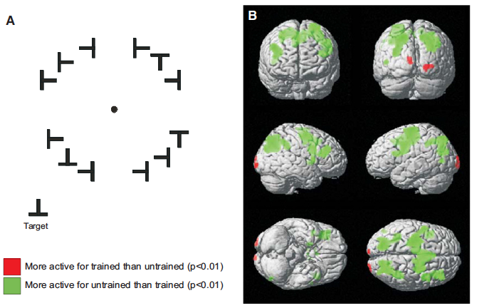
Facilitating plasticity – visual training
- long-term (or even short-term) training on a sensory task often produces substantial improvements in performance, and can change where in the brain sensory processing occurs

Slide 25
3. What are the conditions that allow adult plasticity to be generated?

Slide 26
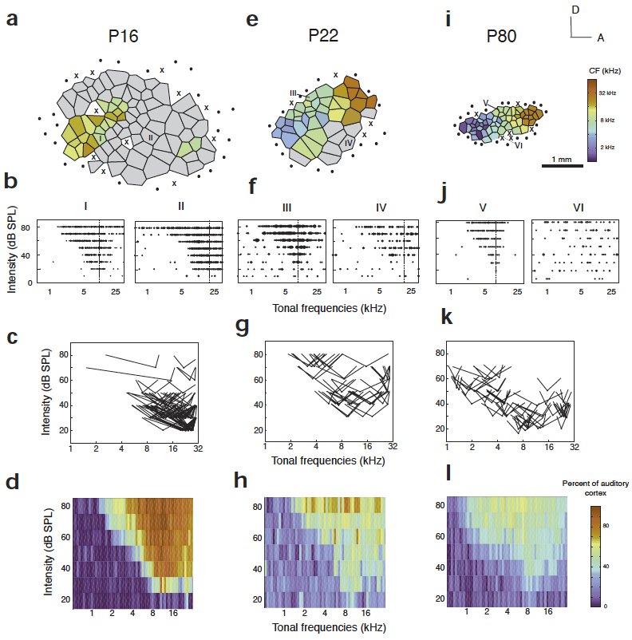
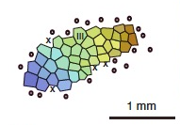
Facilitating plasticity: engagement
tone exposure (largely unchanged)
normal experience
- remember from the rats: simple, passive sensory experience is not enough to drive substantial map reorganization in auditory cortex.
- but, we know that substantial learning and reorganization can occur under the right circumstances. What are the conditions, and the biological signals, that gate adult plasticity?

Slide 27
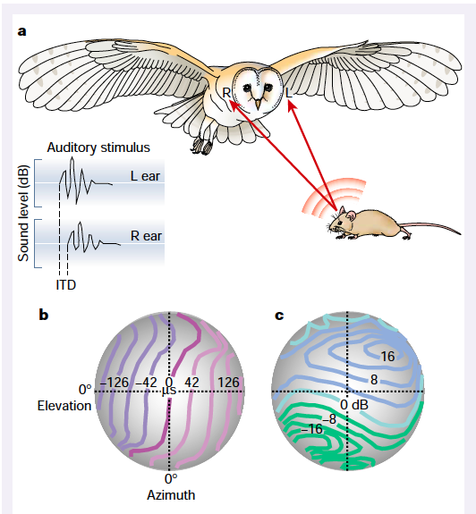
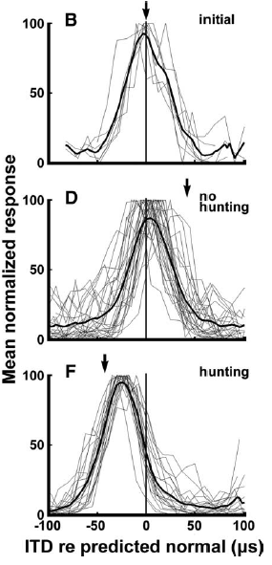

Facilitating plasticity: engagement
- normal: auditory and visual maps are tightly aligned
- owls fed dead mice → some shift in auditory tuning
- owls HUNT for food → leads to much greater shift
- Use prism goggles to drive sensory reorganization in visual/auditory maps of owls
→ plasticity is most effective when sensory system is actively used in a behavior producing a useful outcome

Slide 28
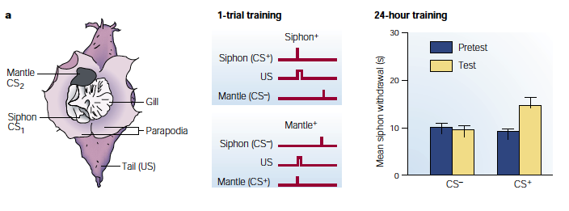
Facilitating plasticity: neuromodulators
- classic demonstration of neuromodulators and sensory learning: Aplysia gill withdrawal reflex.
- touching siphon leads to withdrawal reflex. Pairing siphon touch with unpleasant shock to mantle greatly increases the amount of withdrawal.
- i.e. for same touch stimulus, coincidence of shock leads to induction of plasticity in both synaptic strength and behavior.
- the increased response depends on the neuromodulator serotonin, which acts as a ‘gate’ controlling expression of plasticity depending on context.

Slide 29
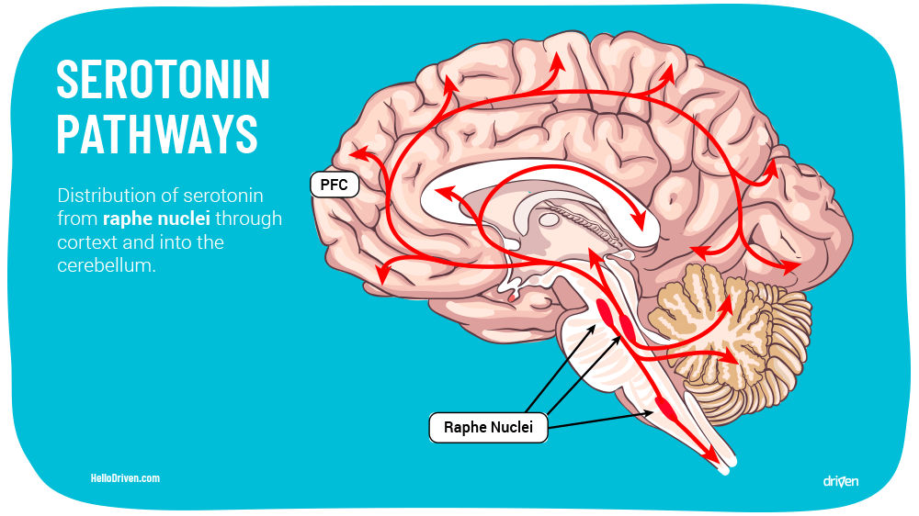
Facilitating plasticity: neuromodulators

Slide 30
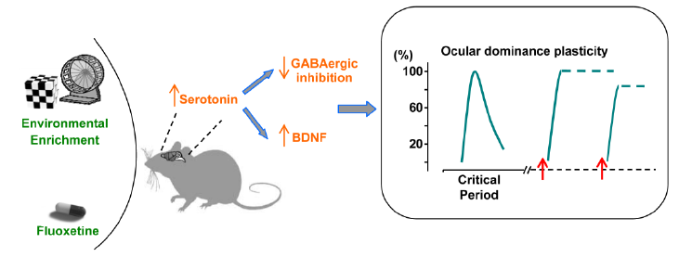
Facilitating plasticity: neuromodulators

Slide 31
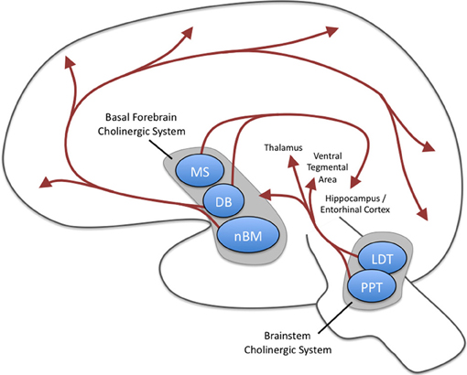
Facilitating plasticity: neuromodulators
- basal forebrain (nucleus basalis) and brainstem ACh systems: composed largely of cholinergic neurons
- project long-range axons broadly throughout the brain, including sensory cortical areas → widespread ACh release; facilitates plasticity
- ACh system is activated most strongly when a sensory stimulus is salient / surprising / engages attention in demanding contexts

Slide 32
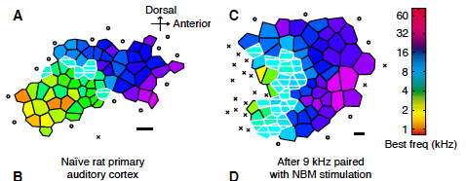
Facilitating plasticity: neuromodulators
normal experience
tone exposure
- expose to 9KHz tones, normal conditions → little to no remapping
no ACh
- expose to 9KHz tones while stimulating nucleus basalis to release acetylcholine → dramatic increase in cortical area
pair w/ ACh stimulation
Cortical map reorganizatino enabled by nucleus basalis activity.
Kilgard & Merzenich (1998) Science 279: 1714
- ACh leads to substantial reorganization of the frequency map → increased representation of the ‘paired’ tone

Slide 33
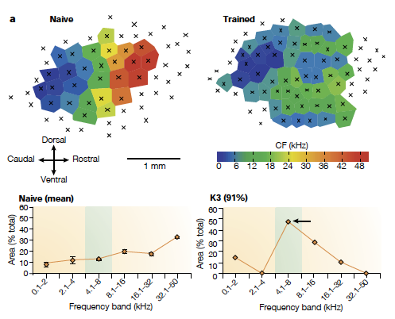
Facilitating plasticity: neuromodulators
The nucleus basalis and memory codes: auditory cortical plasticity.
Weinberger, N.M. Neurobiol. Learn Mem. 80: 268
- Can we do this without zapping the brain with an electrode?
- Yes! Training paradigms that activate neuromodulatory systems by including elements of engagement or reward (e.g. tone → lever press → reward) also drive substantial plasticity. Presumably via dopamine, which acts similarly to ACh

Slide 34

Facilitating plasticity: neuromodulators
- locus ceruleus (blue spot): contains neurons that (like basal forebrain ACh) project widely throughout the brain and release noradrenaline
- LC activity is strongly linked to arousal state and strongly engaging contexts

Slide 35

Facilitating plasticity: neuromodulators
- Schematic of areas that provide input to the noradrenergic system
- common property of neuromodulatory systems (shown here for noradrenaline) – they pool input from a wide range of brain areas to signal when salient events are happening in the environment.

Slide 36

Facilitating plasticity: neuromodulators
- substantia nigra (black stuff), ventral tegmental area (VTA): dopaminergic neurons with widespread axonal projections that release neuromodulators throughout the brain
- change their activity when there is a discrepancy between expected and observed reward value
- dopamine is the classic ‘reward system’ of the brain defined through self-stimulation, etc.

Slide 37


Facilitating plasticity: neuromodulators
- one effect of neuromodulators is to shift thresholds, so that plasticity results from patterns that would otherwise not have an effect

Slide 38



Facilitating plasticity: neuromodulators
- neuromodulators (here, dopamine) also facilitate structural changes that underlie sensory plasticity and learning
A critical time window for dopamine actions on the structural plasticity of dendritic spines.
Yagashita, ...., & Kasai. Science 345: 1616
- increases the amount of anatomical plasticity (growth) in dendritic spines that receive postsynaptic connections

Slide 39

Facilitating plasticity: “re-opening critical window”

Slide 40
4. Engaging plasticity to compensate for deficits and injury

Slide 41

Stereo vision – binocular disparity cues
- random dot stereograms are based on binocular disparity (repeating patterns; some dots are shifted)

Slide 42

Stereo vision – binocular disparity cues

Slide 43


Stereo vision – binocular disparity cues
- neurons in visual processing stream (V1, V2, etc...) respond when cues are equally spaced, or displaced by different amounts
- stereo cues result from difference in position of the same point falling on the left and right retina

Slide 44


Stereo vision – binocular disparity cues

Slide 45

Amblyopia – adult plasticity case study
- during early visual development (critical period), vision in one eye is either blurred or misaligned relative to the other
- lack of matched activity-dependent cues means that stereo vision does not develop properly
F
F
F
F
normal orientation
amblyopia

Slide 46





‘Stereo Sue’
- Sue Barry – amblyopia from birth to age 2
- started binocular vision therapy at age 48; experienced essentially full recovery of stereoscopic vision
http://www.stereosue.com/
- typical treatment: force increased reliance on weaker eye with patches, and/or surgical realignment

Slide 47




Other therapeutic possibilities...
- the problem with training adults (other than Sue): poor compliance with exercises is a limiting factor; need a more engaging way to provide directed visual experience?
- Dennis Levi, UC Berkeley
- provide visual experience to ‘retrain’ visual cortex with first-person shooter games
https://www.youtube.com/watch?v=71RML96XxCI

Slide 48
Things to remember:
(1) Adult plasticity: limited compared to development, but still substantial
- adult cortex can remap to compensate for changes in sensory input
- mostly limited to rewiring of connections within cortex (vs from thalamus)
- in mice, virtually all synapses in outer cortical layers can be replaced
(2) Perceptual learning:
- training induces rapid changes in sensory abilities and neural processing
- often highly specific to the trained stimulus
(3) Therapeutic approaches: reawakening plasticity
- directed sensory experience → force reliance on weakened inputs
- pharmacological treatments to re-engage developmental processes?
- pair sensory experience with attention and reward; may facilitate plasticity
for more effective remapping

